Slide 1
Corporate Overview
Revision 11.0 11/25/2024
1

Slide 2
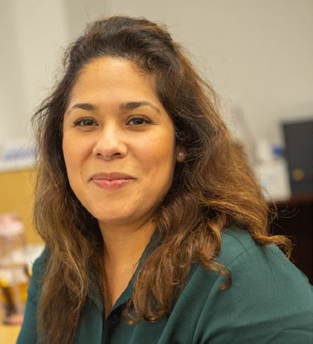
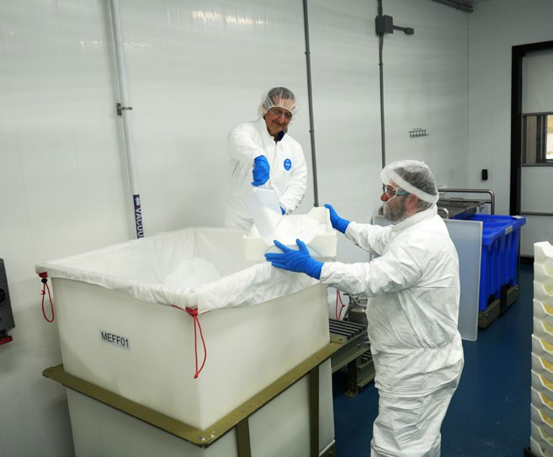
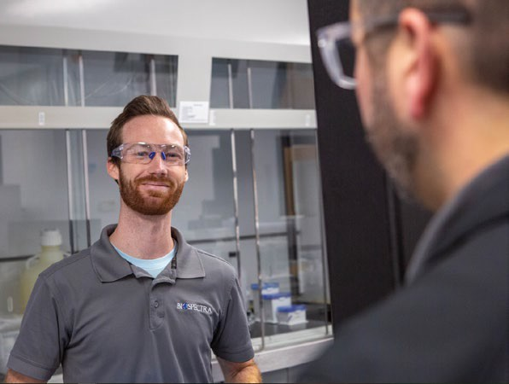
Corporate Vision, Mission, Values
People Matter
Vis ion
Committed to be a le ading manufa cture r of cGMP Fine Chemicals that support the production of safe drugs and vaccines that deliver consistent, reliable therapeutic effect with every dose
Miss ion
To manufacture the hig he s t quality, safe s t and sustainable cGMP Fine Chemicals under the supervision of the most rigorous quality system while upholding the most s tringe nt compliance standards
Value s
Honesty / Integrity / Respect / Safety / Sustainability
BioSpectra rigorously upholds uncompromised standards because… “people matte r”
2

Slide 3
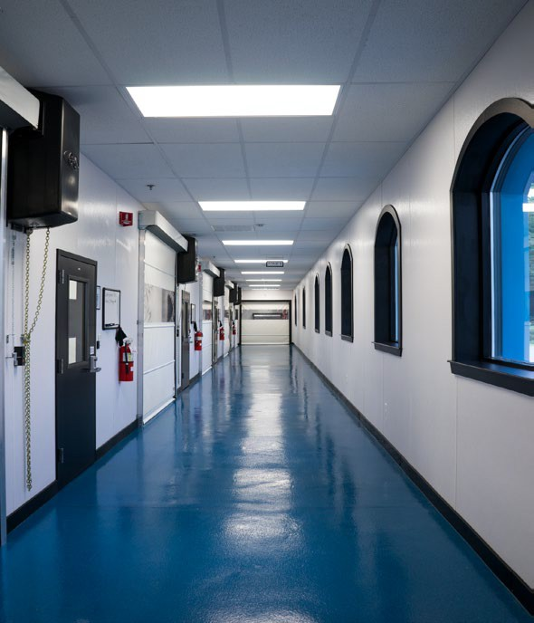
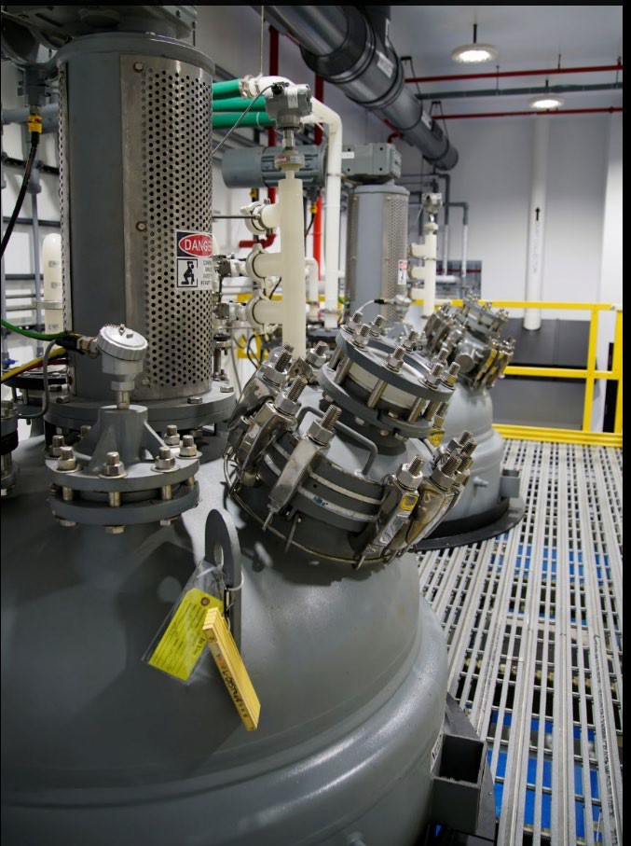
Corporate Profile
BioSpectraTM is a manufacturer of cGMP Fine Chemicals, located in Stroudsburg, Bangor and Wind Gap, PA, USA. We own and operate seven facilities in the USA: two cGMP manufacturing sites, our cGMP warehouse and Supply Chain Center (SCC), and other Lab, Storage and Support facilities. In addition, BioSpectra oversees key raw material production and R&D operations in Canada, India and China – all under stringent quality oversight with full traceability and transparency of all raw material sources.
BioSpectra manufactures a unique line of cGMP Fine Chemicals for use in pharmaceutical processes and finished drug products used by global BioPharma, Bio Contract Manufacturers
a.k.a. Bio-CMOs (for APIs and Finished Drug Products), and Biochemical Companies. This includes bulk Biological cGMP Buffers, large volume cGMP Bio-Buffer Solutions, cGMP Process Fine Chemicals, cGMP Chlorinated Amino Acids, highly purified Parenteral Grade Carbohydrates and Carbohydrate (Dextran) polymers, as well as other novel and compendial Excipients.
Our focus is on specific cGMP product needs of our key accounts, driving the synthesis, purification, testing and packaging of an expanding portfolio of products under full cGMP conditions. All our manufacturing processes are fully validated. Each product is produced under quality managed cGMP systems with various levels of regulatory compliance based on the needs and use of that product. This includes ISO, IPEC, US-FDA and ICH-Q7 Guidance. Testing of all raw materials and finished products are performed on site by BSI staff, in the USA, by our own analytical lab personnel with the exception of Bioburden which is performed by a qualified, audited 3rd party.
Our commitment is to quality, compliance and cGMP manufacturing with unparalleled regulatory & technical support, operating under the most rigorous quality system while holding to the most stringent regulatory demands.
Our goal is to be a valued partner in your secure supply chain for key cGMP Fine Chemicals and the solution to key ingredient issues you may have.
3

Slide 4
FDA Registration
October 16th, 2023
Revision 2
US FDA Registration Statement
BioSpectra is registered with the US FDA at the following locations, with registration renewed on an annual basis.
Firm Name | FDA Establishment Identifier | DUNS | Business Operation | Address | Expiration Date
BioSpectra Inc. | 3003380159 | 957030729 | ANALYSIS; MANUFACTURE | 1474 Rockdale Lane, Stroudsburg, Pennsylvania (PA) 18360, United States (USA) | 12/31/2024
BioSpectra Inc. | 3010476065 | 042724830 | ANALYSIS; API MANUFACTURE; | 100 Majestic Way, Bangor, Pennsylvania (PA) 18013, United States (USA) | 12/31/2024
For further information, please contact info@biospectra.us
4

Slide 5
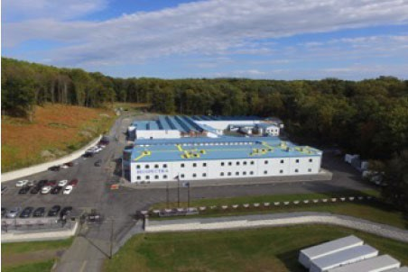
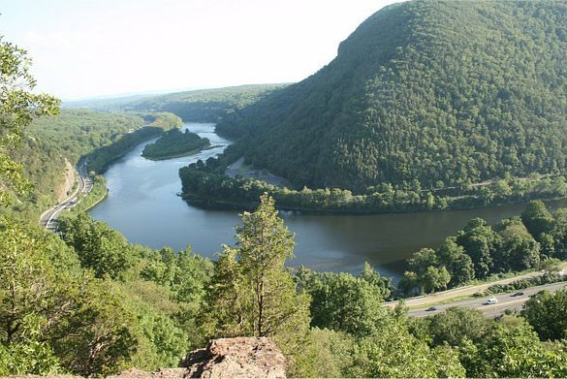
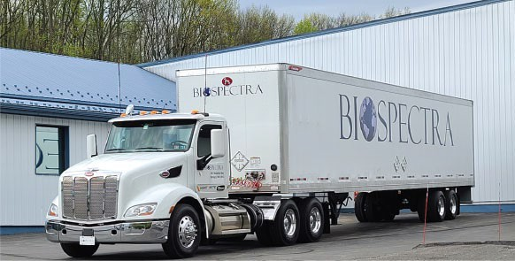
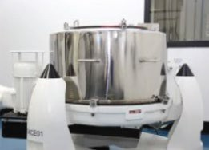
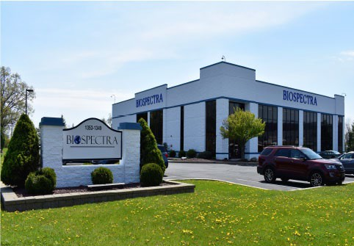
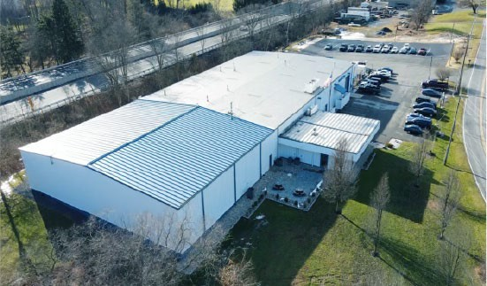
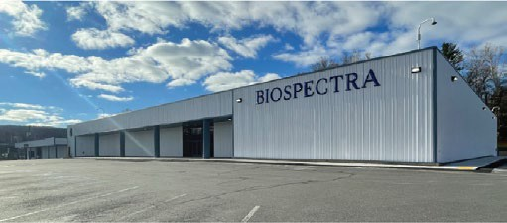
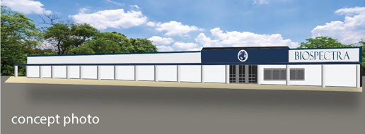
From its humble beginning, BioSpectra remains a pioneer in the development and manufacture of fully validated GMP versions of Biological Buffers and other fine chemicals for a constantly evolving Pharmaceutical industry.
Launched in the foothills of the Poconos and rooted in Eastern Pennsylvania work ethic and culture, BioSpectra has expanded to become a regional, multi-plant manufacturer of High Purity Pharmaceutical Ingredients, serving the leading Pharmaceutical Companies around the World.
Come visit with us as we journey through our history of growth… https://www.biospectra.us/about-us/history
2011 – In 2011, BSI acquired the much larger, Bangor, PA facility to expand manufacturing and expand our portfolio of GMP Pharmaceutical Process Fine Chemicals, Excipients and API’s
1993-1995 - The BioSpectra Organization was created On December 26, 1993 operating from offices near Shawnee on the Delaware. BioSpectra, Inc. (BSI) was first incorporated in Pennsylvania, USA, on September 15, 1995.
1996 – The Original BioSpectra operated from a site in Sciota, PA., manufacturing reagent grade buffers and laboratory chemicals.
2019-2020 – In 2019 and 2020 we acquired several other local properties to house external services (such as our Fleet of cars and trucks, building and ground equipment and non- controlled storage)
2021 – In April of 2021 BSI opened our Corporate Services Center in Wind Gap, PA.
2001 – In 2001, BSI opened the Stroudsburg, Rockdale Lane facility and creating the first fully dedicated manufacturing facility for the production of the repurified GMP Biological Buffers that changed the scale of available cGMP Biological buffers to the BioPharma Industry.
2023 –More recently in January 2023 we opened our 60,000 square foot GMP storage facility on 3rd street in Stroudsburg, PA.
2006 – In 2006, BSI created BioBuffer Solutions Brand to support the need for upstream materials to our critical customers. That brand will undergo further expansion at a new facility in 2024/2025.
The Future of BSI –And we are not done! We are busy working to expand our manufacturing footprint overseas as well and in 2024/2025 we plan to open another 80,000 square foot facility adjacent to our GMP Storage facility to house our expanding analytical services and automated packaging operations.
5

Slide 6
Sustainability and Supply Chain Security
Sustainability
BioSpectra is committed to the ideals of Sustainability and has launched a five-year multi-million dollar capital investment program to help achieve these goals. We are registered with ECOVADIS, SBTi, M2030, and Emitwise.
Supply Chain Security
BioSpectra is fundamentally committed to the ideals of Supply Chain Security. We prosecute an aggressive raw material supplier qualification program, and we take very seriously the global supply-chain situation assessing and reacting to threats with real solutions. BioSpectra continues it’s long history of sourcing and qualifying raw materials so as not to be sole sourced on any key chemical that originates from only one country.
6

Slide 7
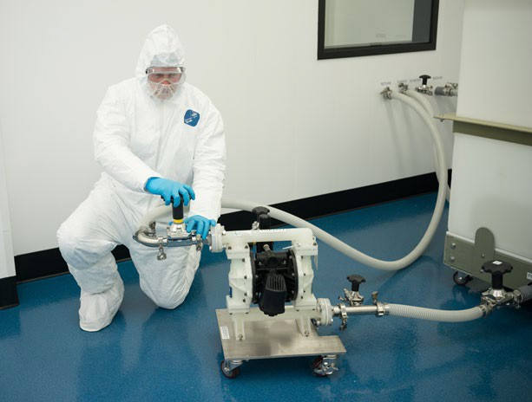
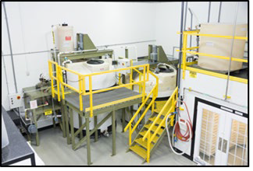
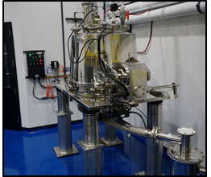
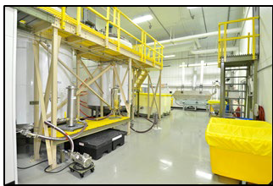
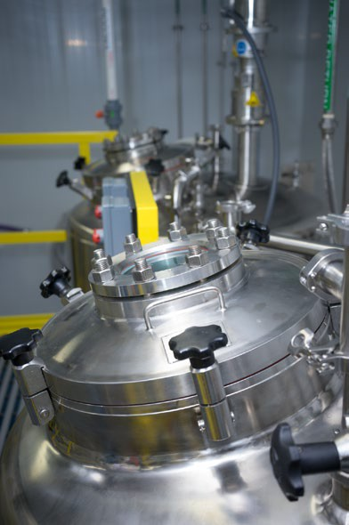
cGMP Manufactured Premium Fine Chemicals
Corporate Commitment to True cGMP Products
Authentic, Secure Supply Chain – 100% Traceable Raw Materials from Qualified Sources
Reliable, Consistent, Uniform, Quality-Based Manufacturing of Premium Ingredients
Fully Validated GMP Manufacturing Systems & Qualified Equipment
True GMP Product Claim – Always Synthesized and/or Purified, Tested and packed under full cGMP
Comprehensive Quality & Regulatory System
FDA Registered & Inspected
Full Transparency in Documentation
Stringent Quality Program & Controls
Rigorous compliance to Global Standards
State-of-the-art Instrumentation & Laboratories
TRUE GMP
BSI does not simply test and package under a
“GMP system”; rather, we a lways incre ase the
qua lity and comp lia nce le ve ls through multiple
steps of synthetic manufacturing and/or
purifica tio n for a ll BioSpectra labeled products.
7

Slide 8
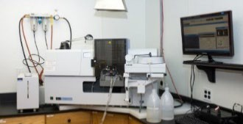
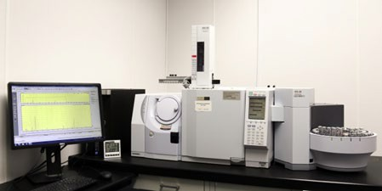
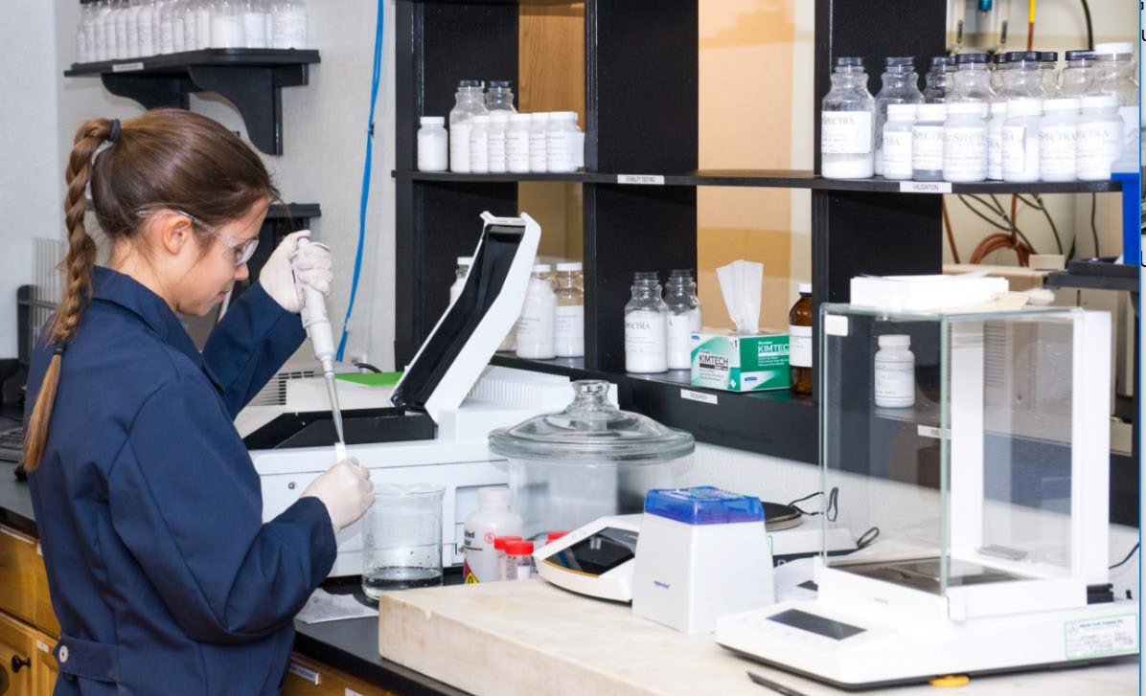
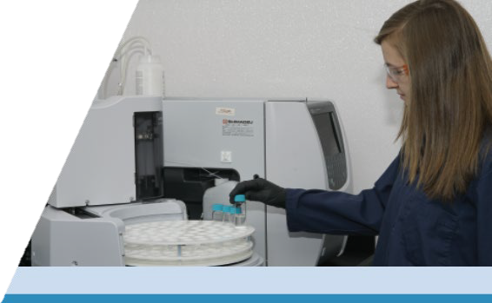
Comprehensive Quality & Regulatory Program
Quality Assurance
excipients

Slide 9
What We Do
GMP
Solutions
Custom Product Specifications
Synthesis
Purification
Bulk Bio Buffers & Buffer Solutions
Dextran Derivates
Small Molecule NCE’s
High Purity Carbohydrates
Parenteral Ingredients
Chlorinated Amino Acids
cGMP Pharma Process
Fine Chemicals
Multi-compendial Excipients

Slide 10
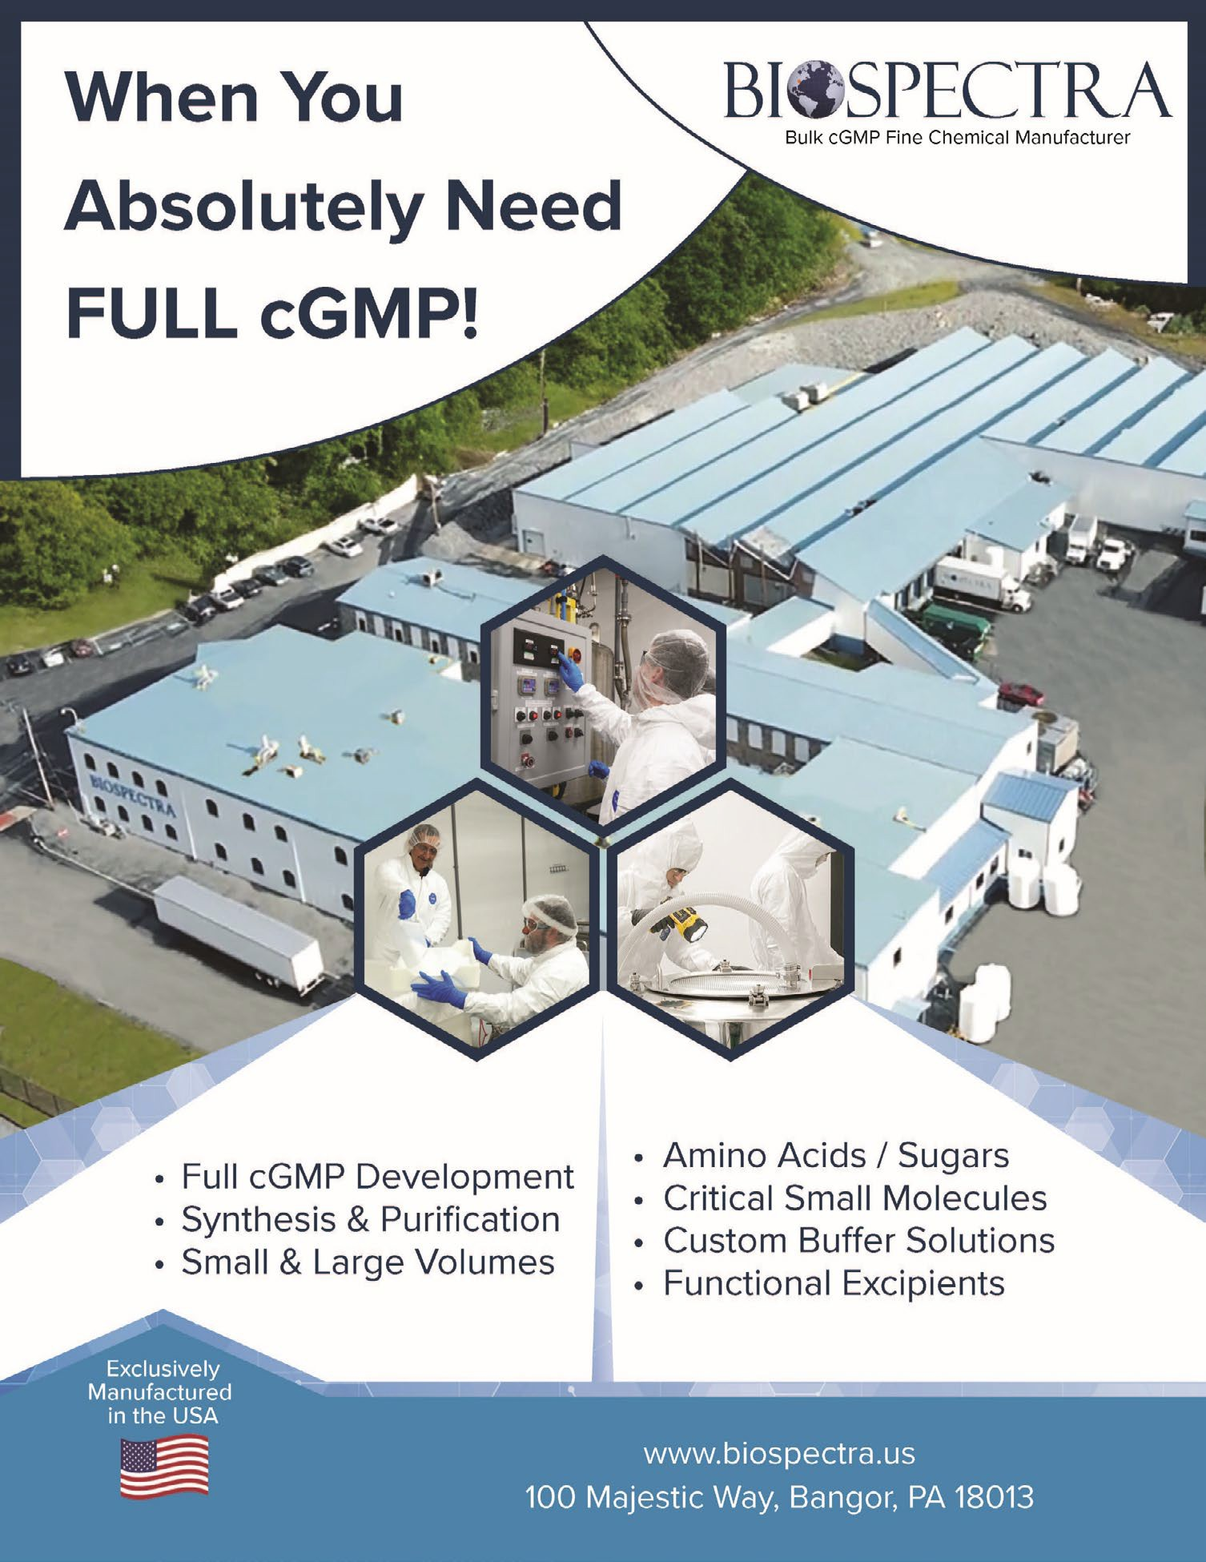
What We Do

Slide 11
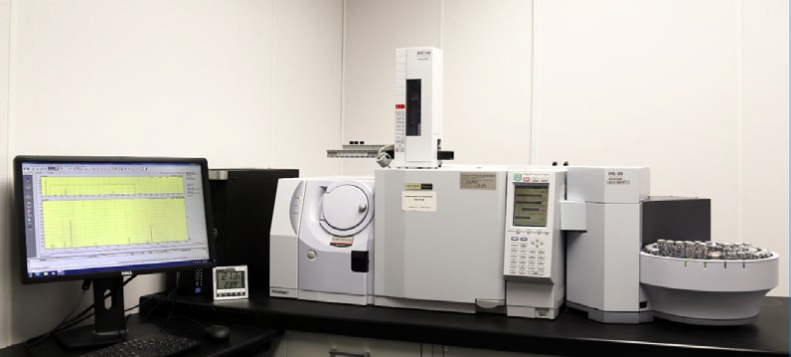
Product Grades & Compliance Levels
Premium Pharmaceutical Ingredients
Bio Ultra & Bio Ultra w/ BET (LBLE)*
Bio Pharma & Bio Pharma w/ BET (LBLE)* Bio Excipient & Bio Excipient w/ BET (LBLE)*
*Note: LBLE = Low Bioburden, Low Endotoxin non-sterile products suitable for further use in parenteral manufacturing and other sterile applications.
cGMP (US-GMP)
IPEC (International GMP)
FDA Registration / Inspection
Internal Controls and Systems
ICH Q7 & other applicable USP & ICH standards

Slide 12
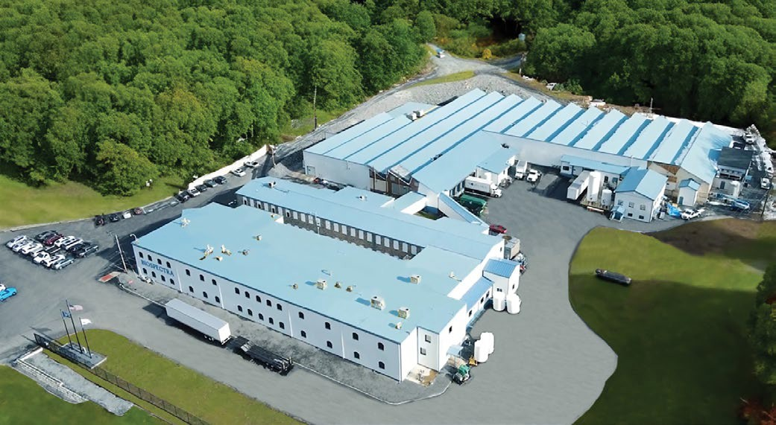
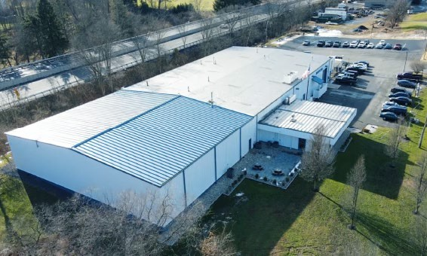
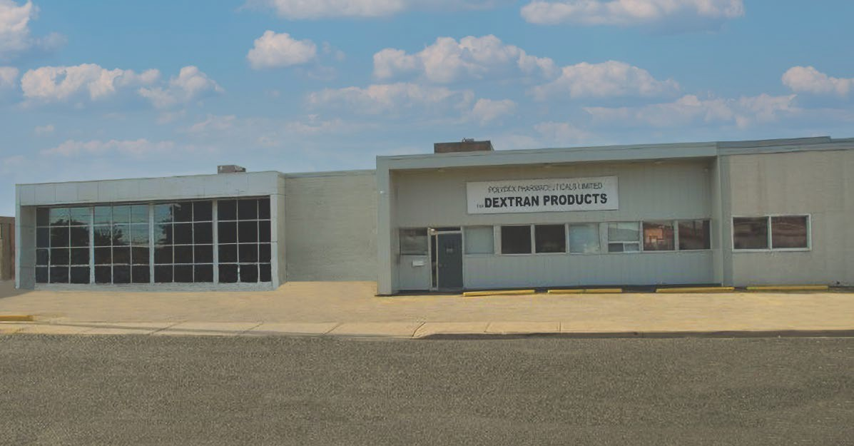
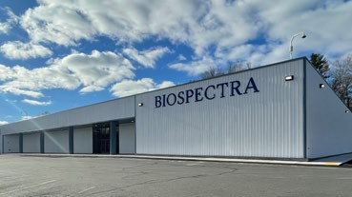
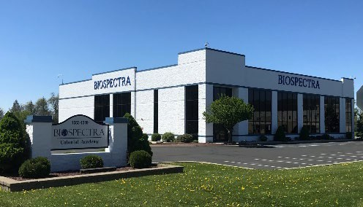
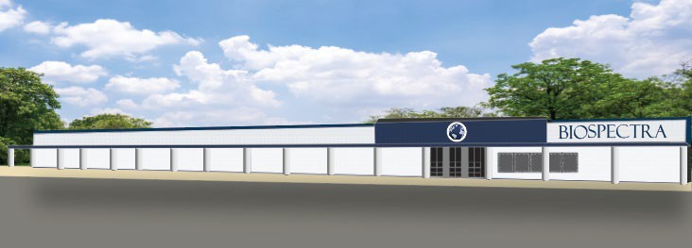
Facility Profile
“Ma je s tic”
“Rockda le ”
Overall
Facilities: 343,000 sq. ft. 52+ Acres
5 Campuses
Staff: 250+ Employees
More Info: www.biospectra.us
Pharmace utical Ingre die nt Manufacturing
Bulk Manufacturing Facility & Head Corporate Offices: Administration, Regulatory Affairs, Quality Assurance & Control
Address: 100 Majestic Way, Bangor, PA 18013
Staff: 125+ Employees | Site: 150,000+sq. ft. on 37+ Acres
Biological Buffe r Manufacturing
Bulk Manufacturing Facility, Quality Assurance & Control Address: 1474 Rockdale Lane, Stroudsburg, PA 18360
Staff: 50+ Employees | Site: 25,000+sq. ft. on 3+ Acres
“Comstock”
“McConne ll”
“Jacobsburg”
Biospe ctra Canada d.b.a ➝ De xtran Products
Address: 421 Comstock Rd, Scarborough, ON M1L 2H5, Canada
Supply Chain Ce nte r
Shipping and Receiving & Security HQ Address: 51 N 3rd Street, Stroudsburg, PA 18360
Staff: 20+ Employees | Site: 60,000+sq. ft. on 2+ Acres
“Fu lme r”
Corporate Se rvices Center
Commercial, IT, HR, Finance & Training Center Address: 1349 Jacobsburg Road, Wind Gap, PA 18091 Staff: 30+ Employees | Site: 25,000+sq. ft. on 2+ Acres
Bio Buffe r Solutions
Wet Chemistry Labs / Raw Material Warehousing Address: 51 N 3rd Street, Stroudsburg, PA 18360
12
Completed Date - 2025

Slide 13
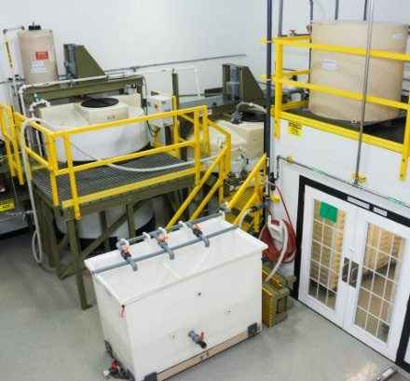
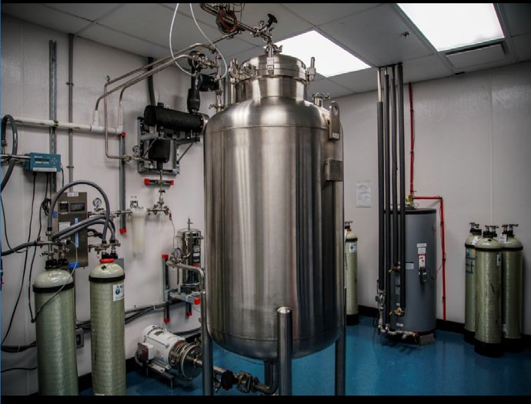
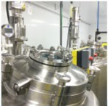
Key Equipment & Manufacturing Scale
Premium Pharmaceutical Ingredients
More than 24 GMP Manufacturing Suites with compliance levels ranging from IPEC to ICH Q7
More than 30 Glass, 316-Stainless Steel and Composite Reactors
Environmentally controlled Packaging Rooms
Quality Control Labs with industry leading instrumentation
Manufacturing Capabilities: Synthesis / Purification / Compounding
Drying Systems: Spray / Fluid Bed / Rotary / Tray
Scale & Capacity
Reactors: Solvent & Alcohol / Corrosive Resistant Glass Lined / Stainless Steel
Reactor Scale: 20L to 6,000L
Solutions Batch Scale: 800L to 14,000L
Dry Batch Scale: 1 kg to 20,000 kg
Overall Operational Capacity: Thousands of Metric Tons per Year

Slide 14
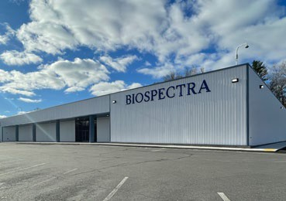
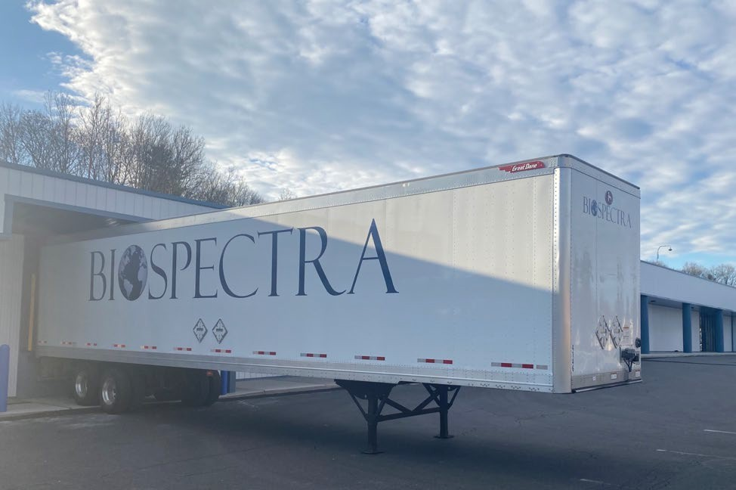
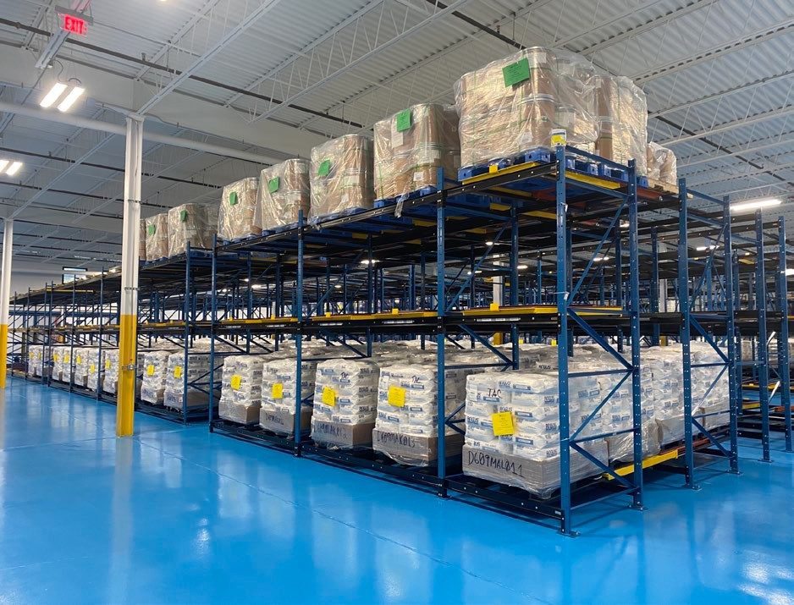
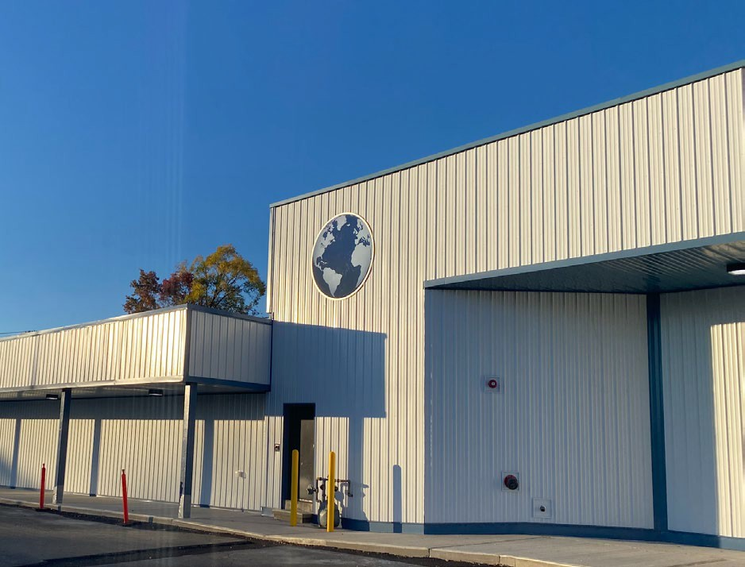
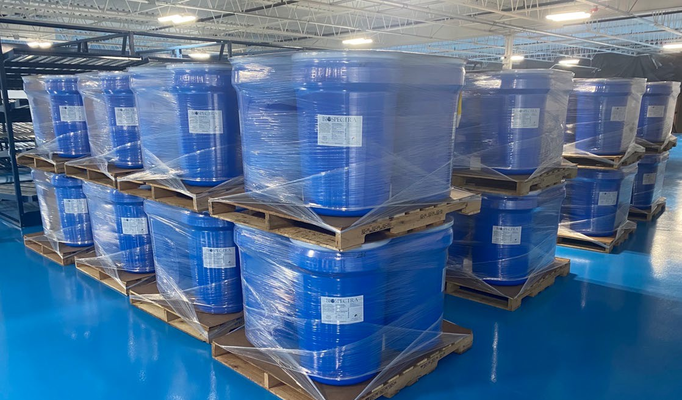
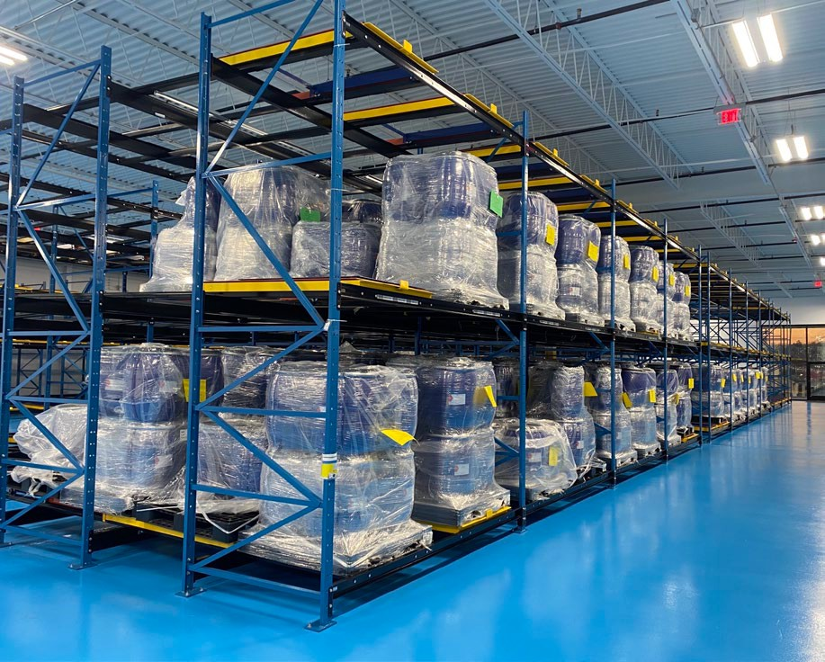
cGMP Warehouse Complex
51 North 3rd Street Stroudsburg, PA 18360

Slide 15
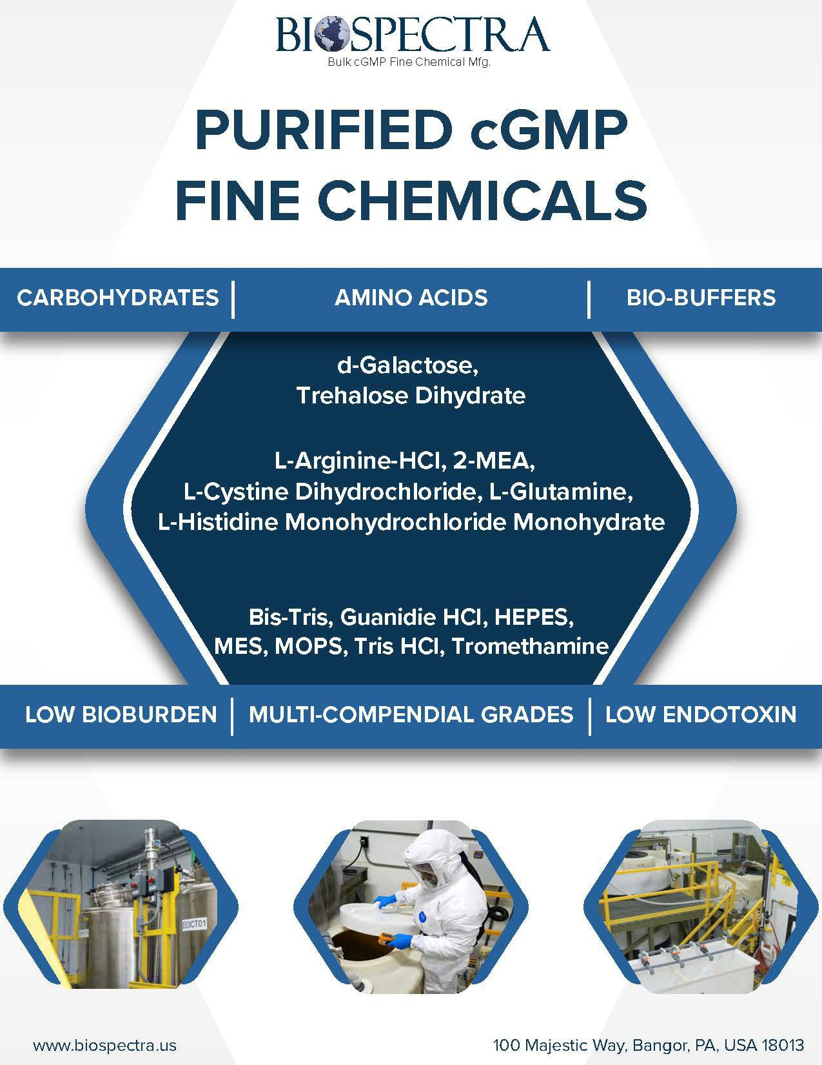

Slide 17
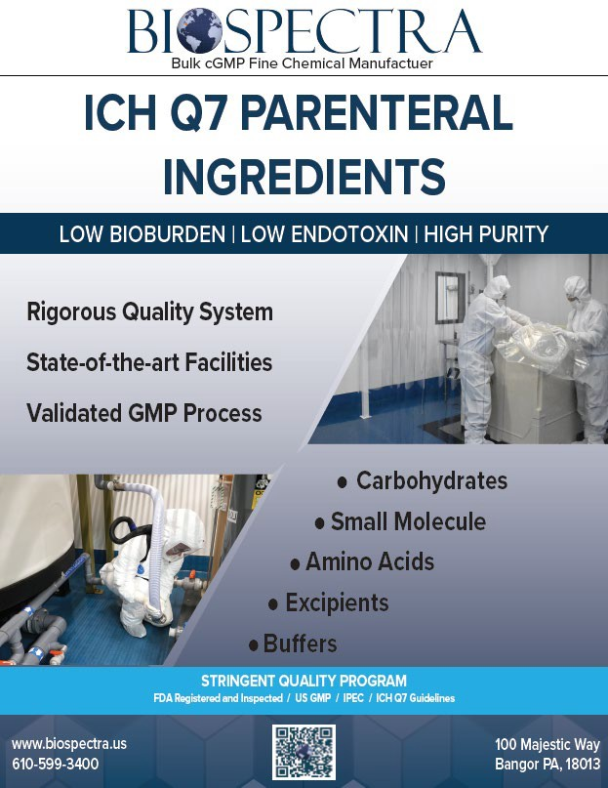

Slide 18
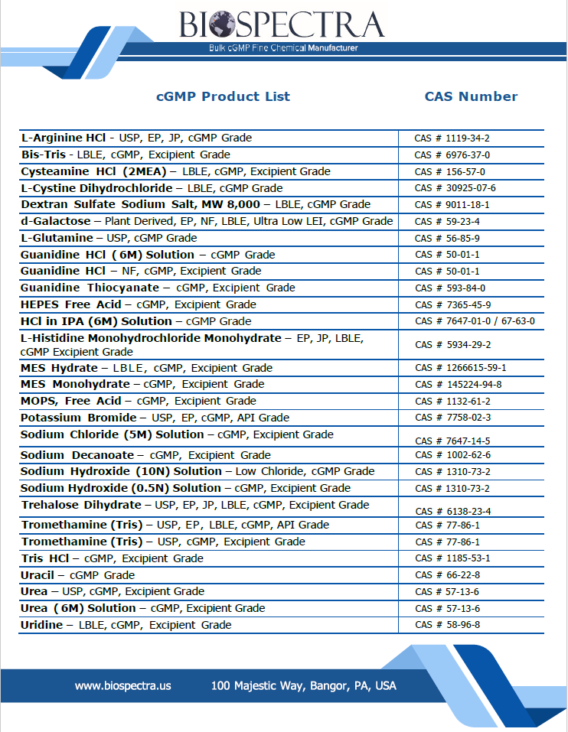

Slide 19
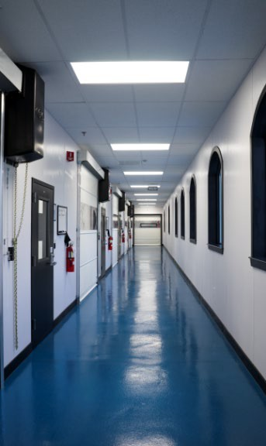
Final Word
We Seek to Service…
Customers who are seeing:
Increased security of supply
A company with a strong growth model to support future commercial demands
A company with a proven track record of commitment to the Pharmaceutical Industry
A company focused on customer needs
A flexible, transparent and responsive supplier
A company committed to Sustainable Solutions
Customers who:
Have critical ingredient issues that fall within our scope of chemistry, capabilities and capacity
Need higher-purity, higher-compliance Pharma ingredients or cGMP process fine chemicals Ingredients
Value full cGMP synthesized and/or purified products
19

